Slide 1
DB Environment, Centralized / Client-Server Architecture for DBMS

Slide 2
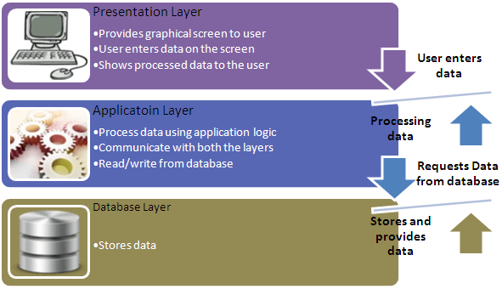


Slide 3
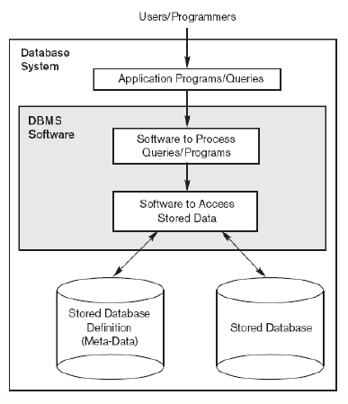
Simplified DBS Environment

Slide 4
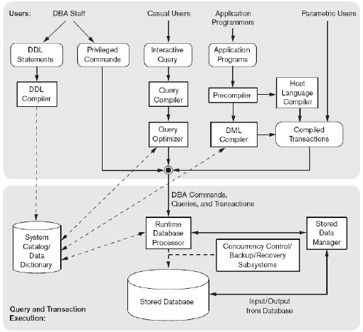
DB Environment

Slide 5
Centralized and
Client-Server DBMS Architectures
Centralized DBMS:
  Combines everything into single system including- DBMS software, hardware, application programs, and user interface processing software.
  User can still connect through a remote terminal – however, all processing is done at centralized site.
Slide 2- <number>

Slide 6

A Physical Centralized Architecture
Slide 2- <number>

Slide 7
Basic 2-tier Client-Server Architectures
Specialized Servers with Specialized functions
  Print server
  File server
  DBMS server
  Web server
  Email server
Clients can access the specialized servers as needed
Slide 2- <number>

Slide 8

Logical two-tier client server architecture
Slide 2- <number>

Slide 9
Clients
Provide appropriate interfaces through a client software module to access and utilize the various server resources.
Clients may be diskless machines or PCs or Workstations with disks with only the client software installed.
Connected to the servers via some form of a network.
  (LAN: local area network, wireless network, etc.)
Slide 2- <number>

Slide 10
DBMS Server
Provides database query and transaction services to the clients
Relational DBMS servers are often called SQL servers, query servers, or transaction servers
Applications running on clients utilize an Application Program Interface (API) to access server databases via standard interface such as:
  ODBC: Open Database Connectivity standard
  JDBC: for Java programming access
Client and server must install appropriate client module and server module software for ODBC or JDBC
Slide 2- <number>

Slide 11
Two Tier Client-Server Architecture
A client program may connect to several DBMSs, sometimes called the data sources.
In general, data sources can be files or other non-DBMS software that manages data.
Other variations of clients are possible: e.g., in some object DBMSs, more functionality is transferred to clients including data dictionary functions, optimization and recovery across multiple servers, etc.
Slide 2- <number>

Slide 12
Three Tier Client-Server Architecture
Common for Web applications
Intermediate Layer called Application Server or Web Server:
  Stores the web connectivity software and the business logic part of the application used to access the corresponding data from the database server
  Acts like a conduit for sending partially processed data between the database server and the client.
Three-tier Architecture Can Enhance Security:
  Database server only accessible via middle tier
  Clients cannot directly access database server
Slide 2- <number>

Slide 13

Three-tier client-server architecture
Slide 2- <number>

Slide 14
Classification of DBMSs
Based on the data model used
  Traditional: Relational, Network, Hierarchical.
  Emerging: Object-oriented, Object-relational.
Other classifications
  Single-user (typically used with personal computers)
  vs. multi-user (most DBMSs).
  Centralized (uses a single computer with one database)
  vs. distributed (uses multiple computers, multiple databases)
Slide 2- <number>

Slide 15
Variations of Distributed DBMSs (DDBMSs)
Homogeneous DDBMS
Heterogeneous DDBMS
Federated or Multidatabase Systems
Distributed Database Systems have now come to be known as client-server based database systems because:
  They do not support a totally distributed environment, but rather a set of database servers supporting a set of clients.
Slide 2- <number>

